Slide 1
Prediction of Co2 Emission from Vehicles
Subject: Data 6O6(Capstone Project)
Professor: Chaojie Wang
Presenter: Ranadeep Reddy

Slide 2
PROBLEM STATEMENT
The environment is significantly impacted by the increased CO2 emissions from automobiles, which exacerbate air pollution and global warming. Even while precise estimation and control of these emissions are vital, current approaches frequently lack accessibility and precision. By creating a machine learning model that is incorporated into a Flask-based application, this project seeks to close this gap. The model will forecast vehicle-generated CO2 emissions, assisting consumers, policymakers, and environmental organizations in making decisions that will contribute to a sustainable future.

Slide 3
OBJECTIVE
First and foremost, the project's goal is to create an effective machine learning model that can reliably forecast CO2 emissions from cars based on their features.
Another objective is to incorporate this model into a user-friendly Flask-based web application that allows users to enter car information and receive accurate CO2 emission estimates.
The model will be rigorously trained, validated, and assessed using industry-standard metrics such as R-squared and Mean Squared Error.
After that, the Flask application will be deployed onto a hosting platform to enable varied user access and interaction. This will allow for the collection of insightful feedback to improve the model's performance and user experience.

Slide 4
SOLUTION
To precisely predict CO2 emissions, the research in this project uses feature engineering and thorough cleaning as part of data preprocessing techniques. The dataset is then refined using linear regression or Support Vector Machines (SVM). The model's precision and dependability are guaranteed by evaluation metrics like R-squared and Mean Squared Error.
Providing an intuitive user interface is the goal of deploying the Flask application on a hosting platform. In order to get crucial input for improving the model's functionality and user experience, it promotes user engagement.

Slide 5
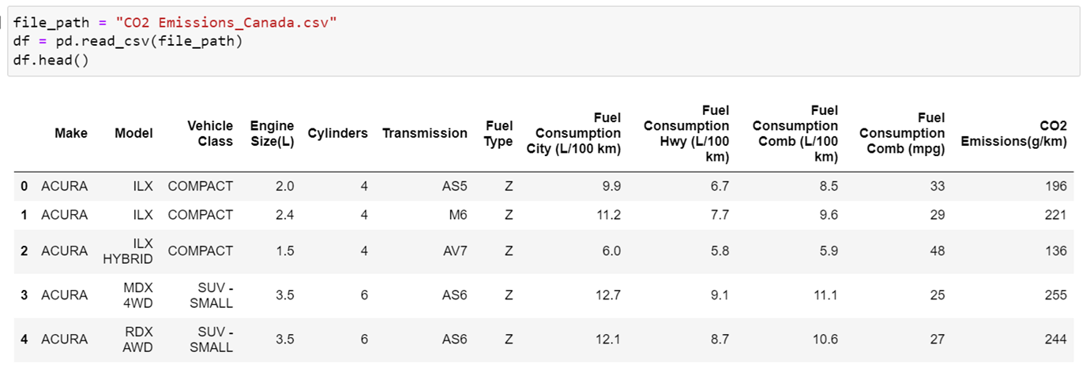
DATA SET
Data set has 6282 Rows and 12 Columns. This Data set is from Kaggle.

Slide 6
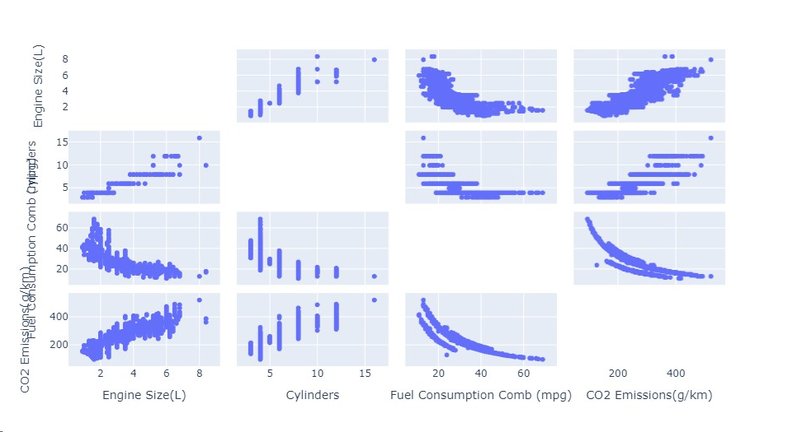

Pair plot for numerical variables

Slide 7
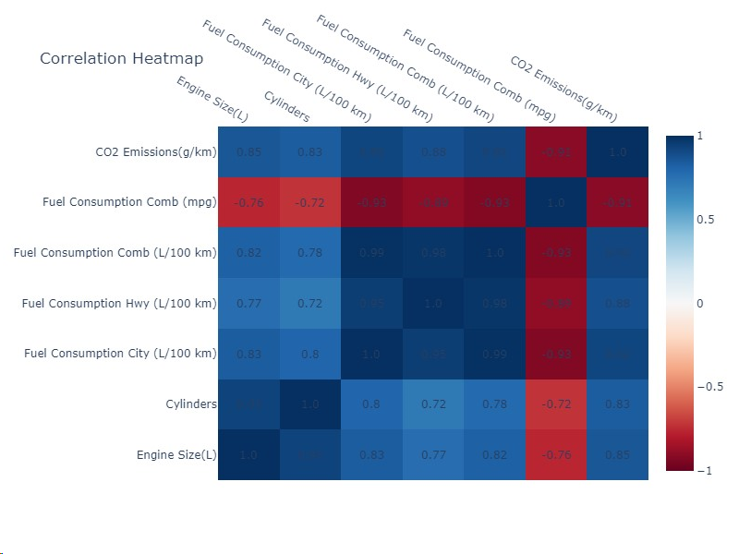
Correlation between different Numerical values

Slide 8
Models Usage
Linear Regression:
Used Linear regression to establish a linear relationship between vehicle attributes and CO2 emission.
Random Forest Regressor:
The random forest model was utilized for its capacity for ensemble learning, which combines several decision trees to improve prediction accuracy. It manages feature interactions and non-linear relationships.
SVM:
SVM was utilized to model the relationship between vehicle attributes and CO2 emissions in a higher-dimensional space because of its adaptability in both regression and classification tasks.

Slide 9
RESULTS
MODEL | R-SQUARED | RMSE | MSE
LINEAR REGRESSION | 0.8825095623681144 |  | 404.1233302241802
RANDOM FOREST | 0.9801556431731288 | 8.261791195950954
XG BOOST | 0.9823237470317739 | 8.261791195950954
SVM | 0.8318240039650543 |  | 578.4627664282878

Slide 10
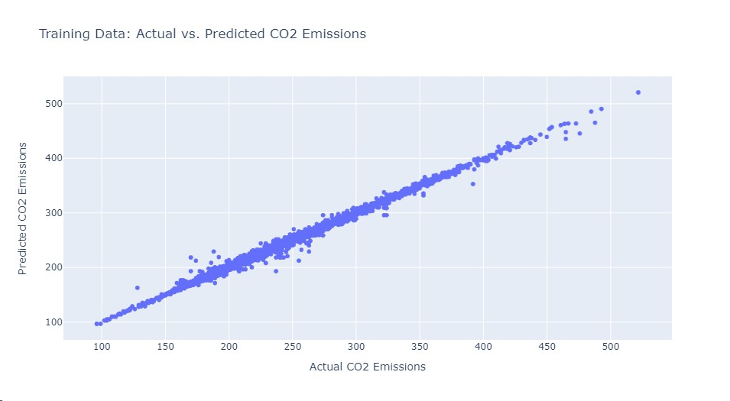

Actual vs Predicted

Slide 11
FUTURE SCOPE
Significant potential for improvement and growth are presented by the future scope of CO2 emission prediction. In order to improve the predictive accuracy, future work may include adding a larger dataset that includes a wider range of variables, such as driving conditions, vehicle technology, and geographic influences. IoT capabilities enable real-time data integration, which has the potential to provide dynamic insights into emission patterns. Investigating cutting-edge machine learning methods like deep learning and neural networks may reveal complex relationships in the data. Working together with lawmakers, automakers, and environmental organizations would guarantee that the models reflect the demands of the real world.

Slide 12
CONCLUSION
To sum up, the objective of this CO2 Emission prediction project was to evaluate and contrast the accuracy of several machine learning models in predicting CO2 emissions from moving vehicles. Four different models were implemented and assessed after a thorough examination and analysis of the dataset, which includes features like engine size, cylinder count, and fuel consumption: linear regression, random forest regression, XGBoost, and support vector machine (SVM). Models were trained and evaluated using performance metrics like R-squared and Mean Squared Error (MSE).

